Slide 1
Vector, List and Sequence

Slide 2
Overview and Reading
Reading: Chapters: 6.1, 6.2, and 6.3
A data structure that stores n elements in a linear order
Called list or sequence
Didn’t we learn “array” and “linked list”?
We are talking about more abstract ADTs than them
…

Slide 3
Three ADTs
Vector (also called Array List)
Access each element using a notion of index in [0,n-1]
Index of element e: the number of elements that are before e
Typically we use the “index” (e.g., [ ])
A more general ADT than “array”
List
Not using an index to access, but use a node to access
Insert a new element e before some “position” p
A more general ADT than “linked list”
Sequence
Can access an element as vector and list (using both index and position)
(Note) Can implement the above ADTs using various ways
array, singly linked list, doubly linked list, circular linked list

Slide 4
Vectors (or Array Lists)

Slide 5
The Array List ADT
The Vector or Array List ADT extends the notion of array by storing a sequence of objects
An element can be accessed, inserted or removed by specifying its index (number of elements preceding it)
An exception is thrown if an incorrect index is given (e.g., a negative index)
Main methods:
at(integer i): returns the element at index i without removing it
set(integer i, object o): replace the element at index i with o
insert(integer i, object o): insert a new element o to have index i
erase(integer i): removes element at index i
Additional methods:
size()
empty()

Slide 6
Applications of Array Lists
Direct applications
Sorted collection of objects (elementary database)
Indirect applications
Auxiliary data structure for algorithms
Component of other data structures
Basically, every place where you can use “array”.

Slide 7
Array-based Implementation of Vector
Use an array A of size N
A variable n keeps track of the size of the array list (number of elements stored)
Operation at(i) is implemented in O(1) time by returning A[i]
Operation set(i,o) is implemented in O(1) time by performing A[i] = o
A
0
1
2
i
n

Slide 8
Insertion
In operation insert(i, o), we need to make room for the new element by shifting forward the n − i elements A[i], …, A[n − 1]
In the worst case (i = 0), this takes O(n) time
A
0
1
2
i
n
A
0
1
2
i
n
A
o
0
1
2
i
n

Slide 9
Element Removal
In operation erase(i), we need to fill the hole left by the removed element by shifting backward the n − i − 1 elements A[i + 1], …, A[n − 1]
In the worst case (i = 0), this takes O(n) time
A
o
0
1
2
i
n
A
0
1
2
i
n
A
0
1
2
i
n

Slide 10
Performance
In the array-based implementation of an array list:
The space used by the data structure is O(n)
size, empty, at and set run in O(1) time
insert and erase run in O(n) time in worst case
If we use the array in a circular fashion, operations insert(0, x) and erase(0, x) run in O(1) time
In an insert operation, when the array is full, instead of throwing an exception, we can replace the array with a larger one

Slide 11
Growable Array-based Array List
In an insert(o) operation (without an index), we always insert at the end
When the array is full, we replace the array with a larger one
How large should the new array be?
Incremental strategy: increase the size by a constant c
Doubling strategy: double the size
Algorithm insert(o)
if t = S.length − 1 then
A ← new array of
size …
for i ← 0 to n−1 do
A[i] ← S[i]
S ← A
n ← n + 1
S[n−1] ← o
For size n array, “re-grow” operation requires n copies

Slide 12
Which is better?: Incremental or Doubling
Comparison Method 1
Given the current size of S = n
Worst-case running time
Incremental strategy: O(1)
Doubling strategy: O(n)
Are you happy?
Happy if your focus is really the worst-case
Unhappy
For doubling strategy, the total number of resizing array size would be small
Can we reconsider the analysis method?

Slide 13
Which is better?: Incremental or Doubling
Comparison Method2
Compute the total time T(n) needed to perform a series of n insert(o) operations
Assume that we start with an empty stack represented by an array of size 1
We call amortized time of an insert operation the average time taken by an insert over the series of operations, i.e., T(n)/n
This can be a fairer comparison in some cases
Amortized analysis (분할상환분석 in Wiki)
Notes:
학생들이 average-case analysis와 혼동을 일으킬 수 있다. 설명을 준비해야 한다.

Slide 14
Incremental Strategy Analysis
We replace the old array with a new one k = n/c times
The total time T(n) of a series of n insert operations is proportional to
n + c + 2c + 3c + 4c + … + kc =
n + c(1 + 2 + 3 + … + k) =
n + ck(k + 1)/2
Since c is a constant, T(n) is O(n + k²), i.e., O(n²)
The amortized time of an insert operation is O(n)

Slide 15
Doubling Strategy Analysis
We replace the old array with a new one k = log₂ n times
The total time T(n) of a series of n insert operations is proportional to
n + 1 + 2 + 4 + 8 + …+ 2^{k} = n + 2^{k + 1} − 1 =
3n − 1
T(n) is O(n)
The amortized time of an insert operation is O(1)
geometric series
2
4
1
1
8

Slide 16
Professor, I have a question
In “computing spans”, why didn’t you do amortized analysis?
Can we do it?
Is it meaningful?
Think about this!
I am ready to discuss if you get your version of answer ready.
Algorithm spans2(X, n) #
S ← new array of n integers n
A ← new empty stack 1
for i ← 0 to n − 1 do n
while (¬A.empty() ∧
X[A.top()] ≤ X[i] ) do n
A.pop() n
if A.empty() then n
S[i] ← i + 1 n
else
S[i] ← i − A.top() n
A.push(i) n
return S 1

Slide 17
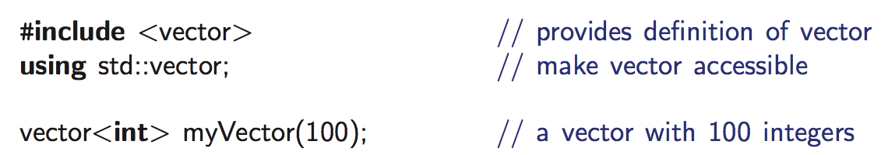
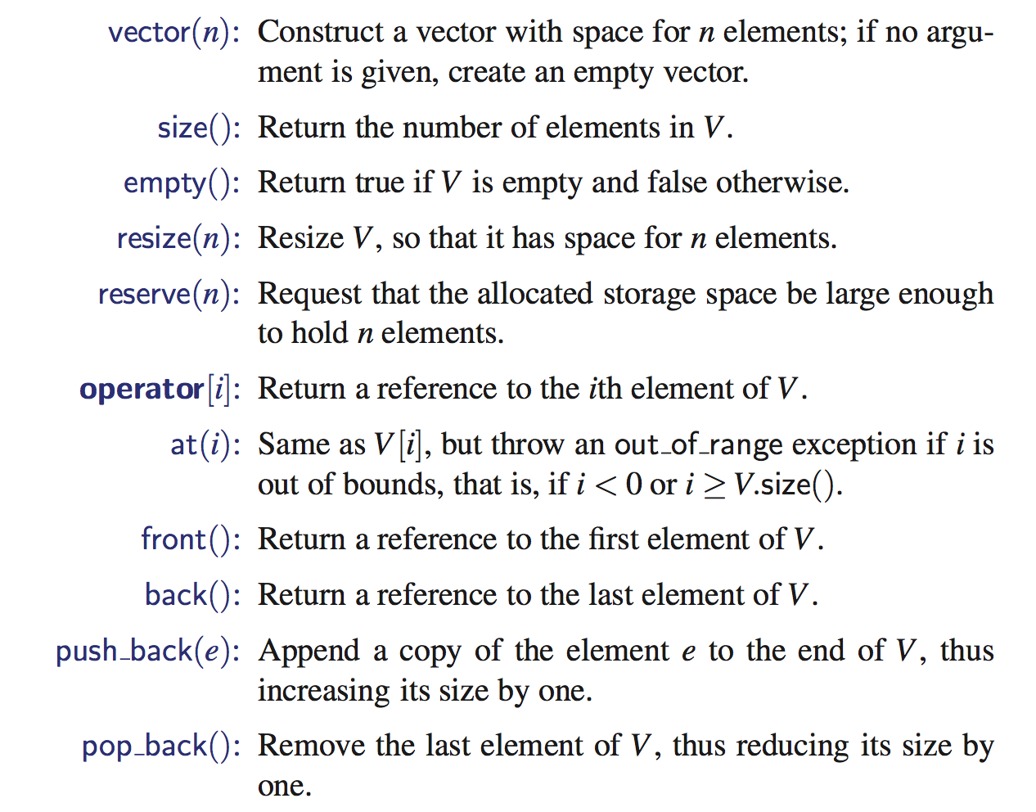
Vectors in C++ STL
Difference between resize() and reserve()?

Slide 18
Logistics
First programming assignment
Deadline: Sep, 19th
Problem Solving Homework
Deadline: Oct, 1st
You should keep reading the textbook
Sep 24th, 26th : No class
Thanksgiving

Slide 19
Last Class
Vector and List
Vector
Access elements by “index”
Incremental vs. Doubling Strategy
Amortized analysis

Slide 20
Lists

Slide 21
(Node) List ADT
The Node List ADT models a sequence of positions storing arbitrary objects
It establishes a before/after relation between positions
Generic methods:
size(), empty()
Iterators:
begin(), end()
Update methods:
insertFront(e), insertBack(e)
removeFront(), removeBack()
Iterator-based update:
insert(p, e)
remove(p)
(Question) No method for accessing a specific node?
We will talk about this later

Slide 22
Implementation based on DLL (covered this)
A doubly linked list provides a natural implementation of the Node List ADT
Nodes implement Position and store:
element
link to the previous node
link to the next node
Special trailer and header nodes
prev
next
elem
node
header
nodes/positions
trailer
elements

Slide 23
Performance
In the implementation of the List ADT by means of a doubly linked list
The space used by a list with n elements is O(n)
The space used by each position of the list is O(1)
All the operations of the List ADT run in O(1) time

Slide 24
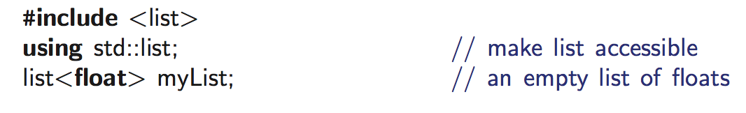
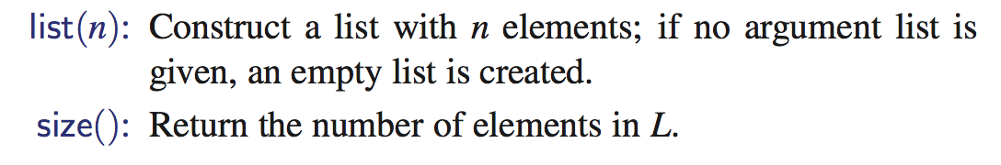
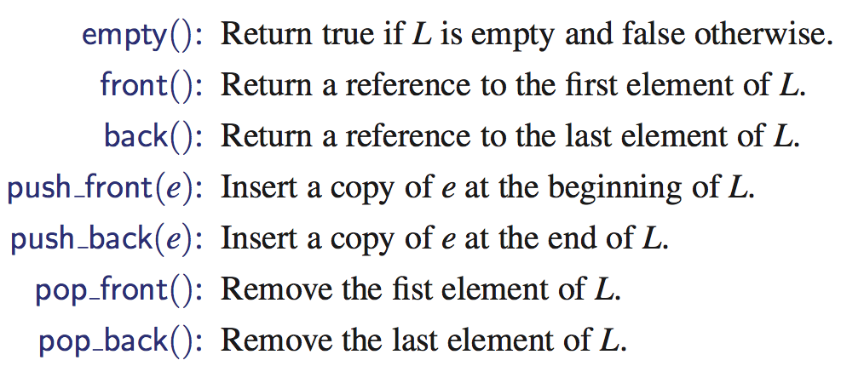
Lists in C++ STL

Slide 25
Containers, Iterators, and Generic algorithms

Slide 26
Sorting: Vector and List
I want to find “yiyung” in Vector or List objects
vector<string> V(100);
list<string> L(100);
// some data insertion to V and L
//Design 1: different function
find_vector(&V);
find_list(&L);
//Design 2: function overloading
find(&V);
find(&L);
Do you like these? Why? Why not?

Slide 27
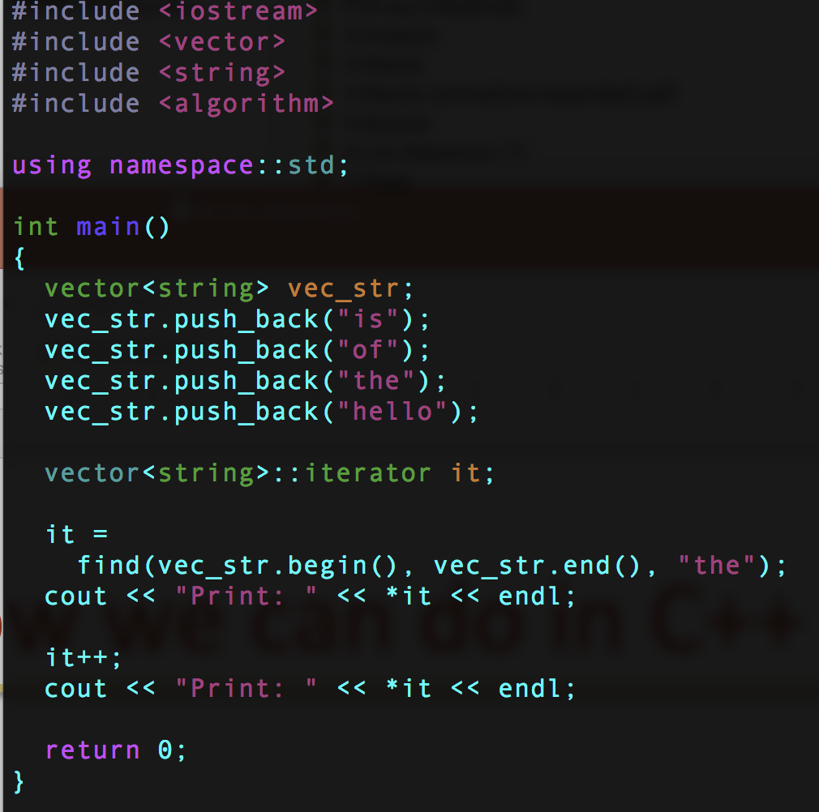
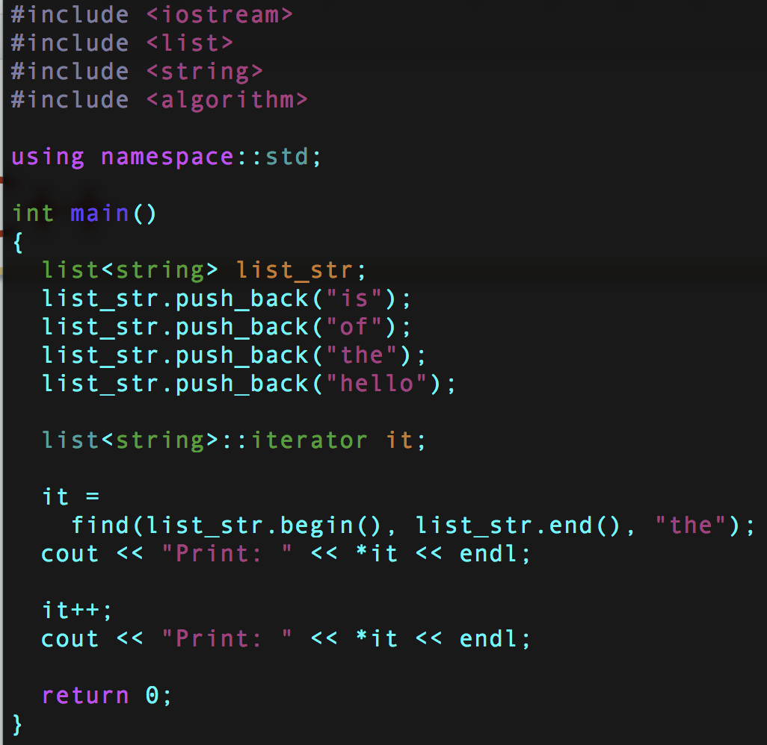
This is how we can do in C++
It is cool. But why is it cool?

Slide 28
Mysterious things
iterator? Looks like a “position” of vector or list. Hmm…..

Slide 29
Goal and Design Challenge
Lots of data structures (or classes in C++) that can contain various types of elements
“Container”
Examples: Vector, List, deque, set, map, etc …
How are you going to design this concept?
Again, from C++ STL designer’s perspective
algorithms
Vector
find,
max, min,
transform,
etc …
Position abstraction
List
………

Slide 30
Position ADT
The Position ADT models the notion of place within a data structure where a single object is stored
It gives a unified view of diverse ways of storing data, such as
a cell of an array
a node of a linked list
“A” method of accessing the element at position p:
object p.element(): returns the element at position
In C++ it is convenient to implement this as *p
Operator overloading
Implemented as “iterator” in C++

Slide 31
Containers and Iterators in C++
An iterator abstracts the process of scanning through a collection of elements
A container is an abstract data structure that supports element access through iterators
Data structures that support iterators
Examples include Stack, Queue, Vector, List
begin(): returns an iterator to the first element
end(): return an iterator to an imaginary position just after the last element
An iterator behaves like a pointer to an element
*p: returns the element referenced by this iterator
++p: advances to the next element
Extends the concept of position by adding a traversal capability

Slide 32
Example codes again
Ah-ha, it’s an iterator!

Slide 33
Various Iterators
(standard) iterator: allows read-write access to elements
const iterator: provides read-only access to elements
bidirectional iterator: supports both ++p and –p
random-access iterator: supports both p+i and p-i

Slide 34
STL Iterators in C++
Each STL container type C supports iterators:
C::iterator – read/write iterator type
C::const_iterator – read-only iterator type
C.begin(), C.end() – return start/end iterators
This iterator-based operators and methods:
*p: access current element
++p, --p: advance to next/previous element
C.assign(p, q): replace C with contents referenced by the iterator range [p, q) (from p up to, but not including, q)
insert(p, e): insert e prior to position p
erase(p): remove element at position p
erase(p, q): remove elements in the iterator range [p, q)

Slide 35
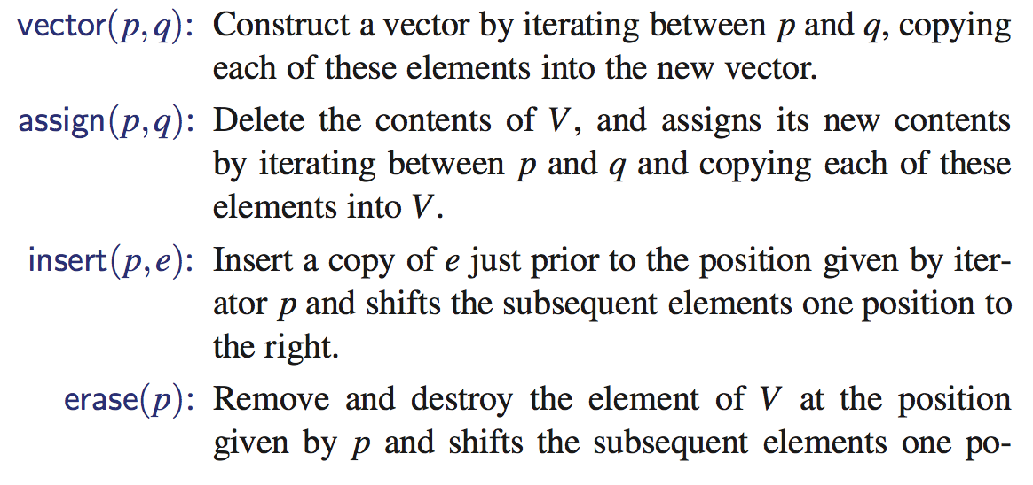
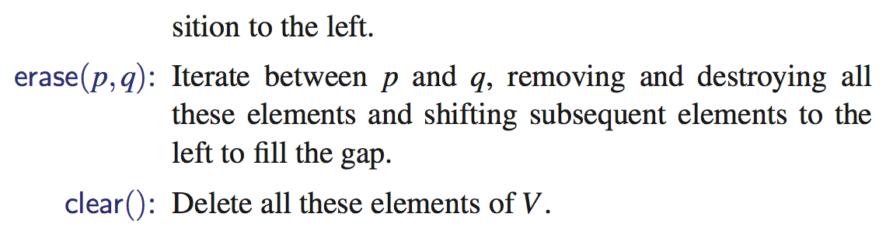
Back to Iterator: STL Iterator-based Functions

Slide 36
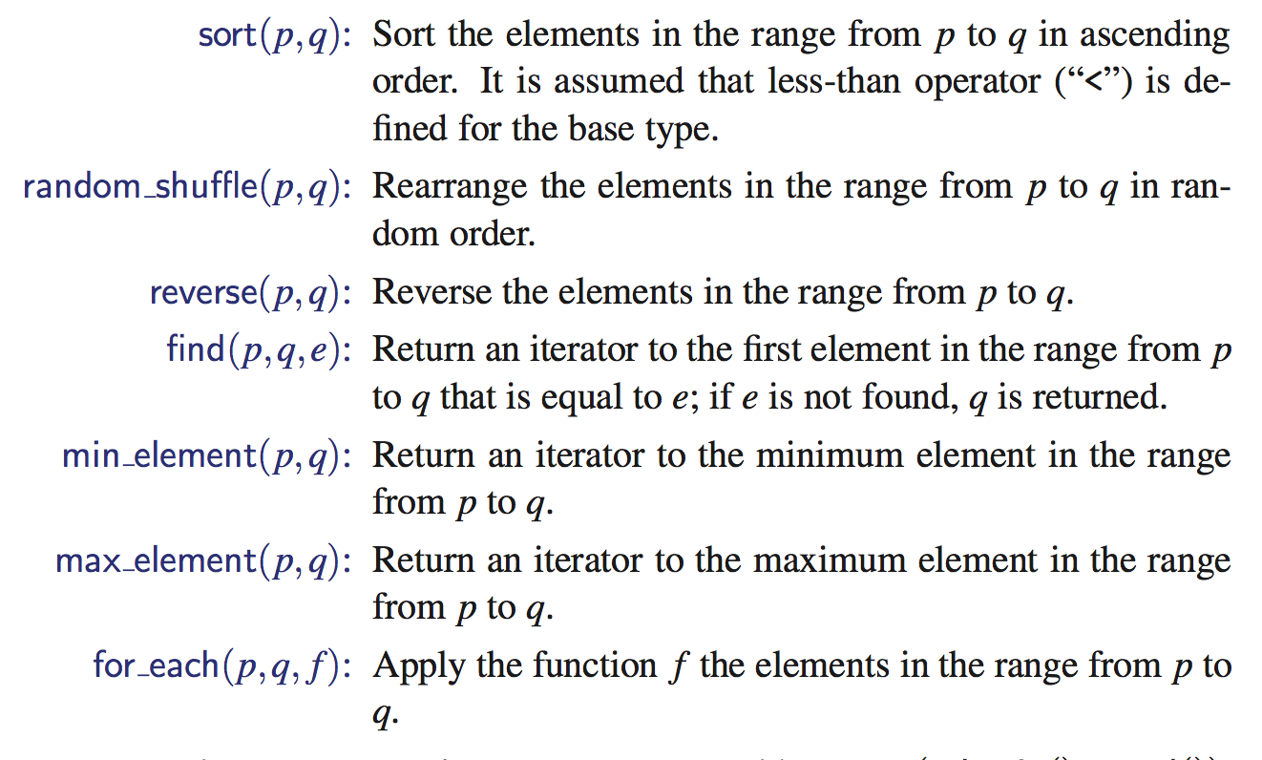
STL Containers and Algorithms
#include <algorithm>
STL Vector
STL deque
STL List
http://www.cplusplus.com/reference/algorithm/

Slide 37
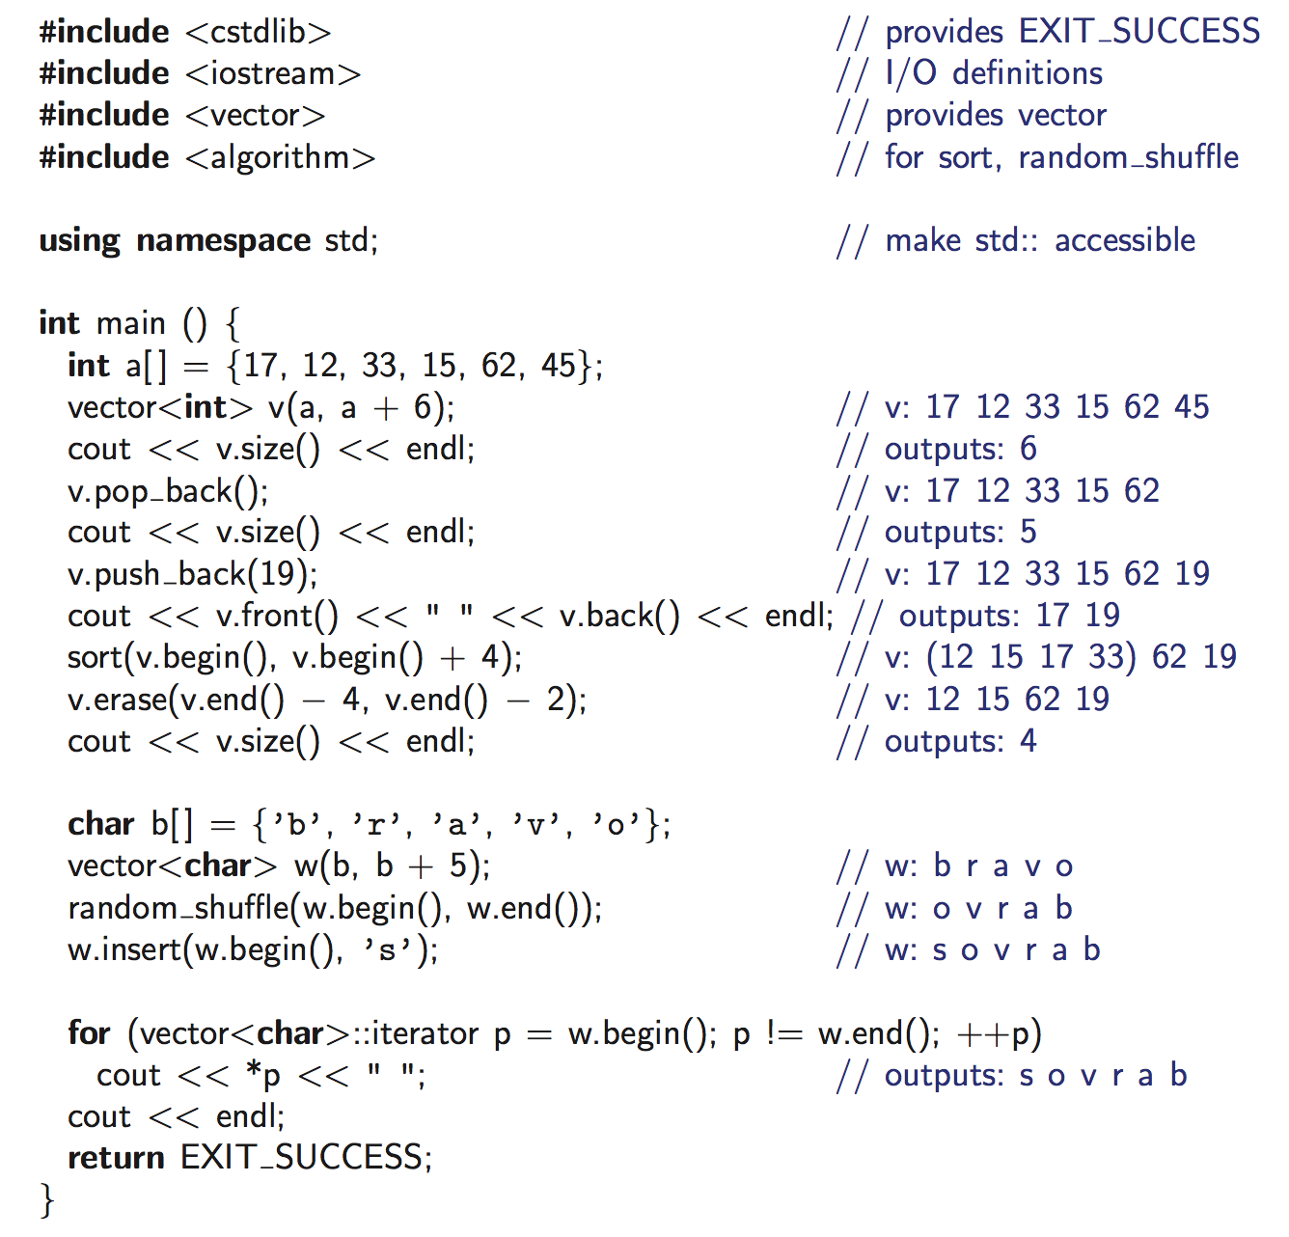
Example Code

Slide 38
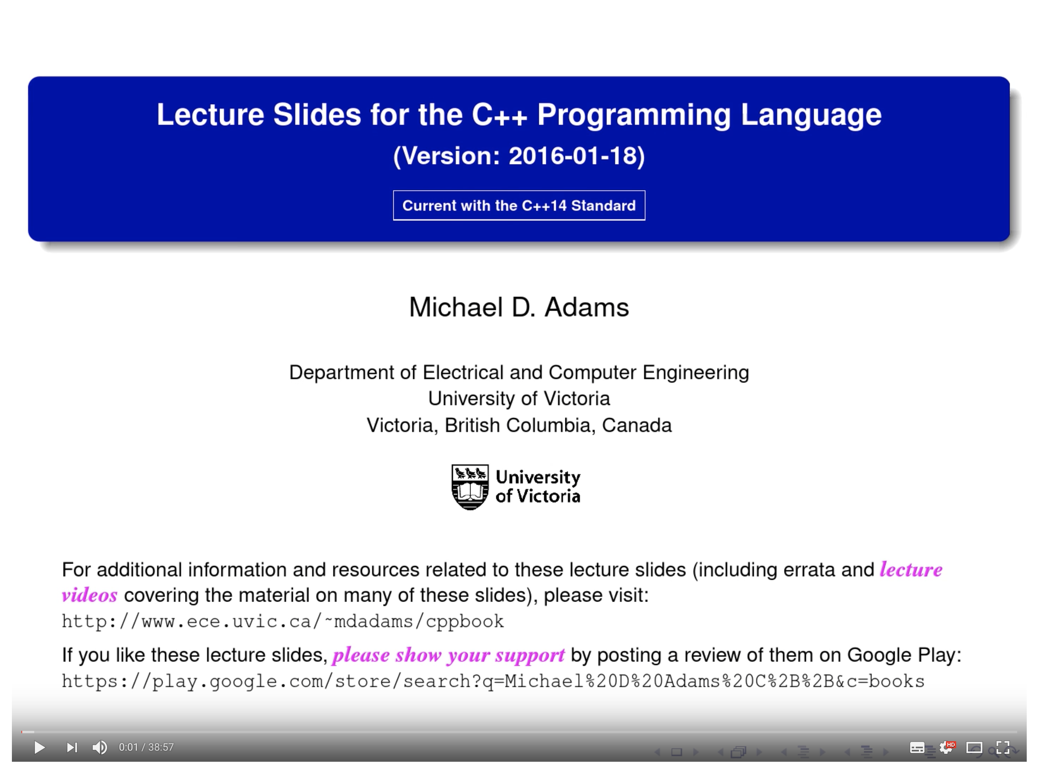
If you want to know more about iterators,
Please watch this video
Please
I hate to answer the question “Is this included in the exam?”
https://www.youtube.com/watch?v=TxufBysSPK0

Slide 39
What should be your next question?
Can I implement iterators in C++, in addition to just knowing how to use them?
Someone like the C++ STL designer
Ch 6.2.3: Some level of explanation:
Beyond the topic of this class
I will be happy to discuss this if you visit my office.

Slide 40
Sequences

Slide 41
Sequence ADT
The Sequence ADT is the union of the Array List and Node List ADTs
Elements accessed by
Index, or
Position
Generic methods:
size(), empty()
ArrayList-based methods:
at(i), set(i, o), insert(i, o), erase(i)
List-based methods:
begin(), end()
insertFront(o), insertBack(o)
eraseFront(), eraseBack()
insert (p, o), erase(p)
Bridge methods:
atIndex(i), indexOf(p)

Slide 42
Applications of Sequences
The Sequence ADT is a basic, general-purpose, data structure for storing an ordered collection of elements
Direct applications:
Generic replacement for stack, queue, vector, or list
small database (e.g., address book)
Indirect applications:
Building block of more complex data structures

